Slide 1
Normalisation Example

Slide 2
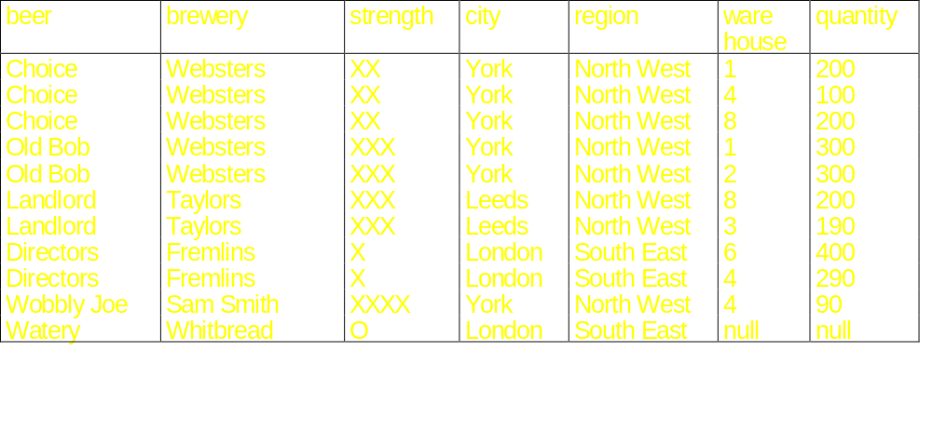
Normalisation Example
BEER_DATABASE
Additional Notes: Warehouses are shared by breweries.
Each beer is unique to the brewer. Each brewery is based in a city.

Slide 3
Minimal Sets of Functional Dependencies
A set of functional dependencies F is minimal if:
1. Every dependency F has a single determined attribute A
2. We cannot remove any dependency from F and still have a set of dependencies equivalent to F
3. We cannot replace and dependency X → A in F with a dependency A→ X, where A ⊂ X and still have a set of dependencies that is equivalent to F
I.e. a canonical form with no redundancies
(beer, brewery, strength, city, region, warehouse, quantity)
beer→ brewery
beer→ strength
brewery → city
city → region
beer, warehouse, → quantity

Slide 4
Relational Synthesis Algorithm into 3NF:
(beer, brewery, strength, city, region, {warehouse, quantity})
set D := { R } ; P. 426, P. 431
1. Find a minimal cover G for F
2. For each determinant X of a functional dependency that appears in G
  create a relation schema { X ∪ A1, X ∪ A2…X ∪ Am} in D where
  X → A1, X → A1, … X → A1m are the only dependencies in G with X as the determinant;
3. Place any remaining (unplaced) attributes in a single relation to ensure attribute preservation property so we don’t lose anything.
4. If none of the relations contains a key of R, create one more relation that contains attributes that form a key for R.
beer→ brewery (beer, brewery, strength)
beer→ strength
brewery → city (brewery, city)
city → region (city, region)
beer, warehouse, → quantity (beer, warehouse, quantity)

Slide 5
Step-wise normalisation:
(beer, brewery, strength, city, region, {warehouse, quantity})
beer→ brewery, strength partial dependency
brewery → city transitive dependency
city → region transitive dependency
beer, warehouse, → quantity repeating group
1NF remove repeating group
(beer, brewery, strength, city, region, {warehouse, quantity})
(beer, warehouse, quantity)
beer, warehouse, → quantity
(beer, brewery, strength, city, region)
beer→ brewery, strength
transitive dependency brewery → city
transitive dependency city → region

Slide 6
(beer, brewery, strength, city, region)
beer→ brewery, strength
brewery → city transitive dependency
city → region transitive dependency
2NF no partial dependencies
3NF/BCNF no transitive dependencies
(beer, brewery, strength, city, region)
(city, region)
city → region (beer, brewery, strength, city)
beer→ brewery, strength
brewery → city
(brewery, city)
brewery → city
(beer, brewery, strength)
beer→ brewery, strength
Take the most indirect transitive dependencies

Slide 7
Using BNCF decomposition algorithm:
(beer, brewery, strength, city, region, warehouse, quantity)
beer→ brewery, strength partial dependency
brewery → city transitive dependency
city → region transitive dependency
beer, warehouse, → quantity
Directly to BCNF
take a violating dependency and form a relation from it.
First choose a direct transitive dependency and its closure
(beer, brewery, strength, city, region, warehouse, quantity)
brewery → city
(brewery, city, region)
brewery → city
city → region transitive dependency
(beer, brewery, strength, warehouse, quantity)
beer→ brewery, strength partial dependency
beer, warehouse, → quantity

Slide 8
Using BNCF decomposition algorithm:
(beer, brewery, strength, city, region, warehouse, quantity)
beer→ brewery, strength partial dependency
brewery → city transitive dependency
city → region transitive dependency
beer, warehouse, → quantity
take a violating dependency and form a relation from it.
First the partial dependency and its closure
(beer, brewery, strength, city, region, warehouse, quantity)
beer→ brewery, strength
(beer, brewery, strength, city, region)
beer→ brewery, strength
brewery → city transitive dependency
city → region transitive dependency
normalise as before...
(beer, warehouse, quantity)
beer, warehouse, → quantity

